Slide 1
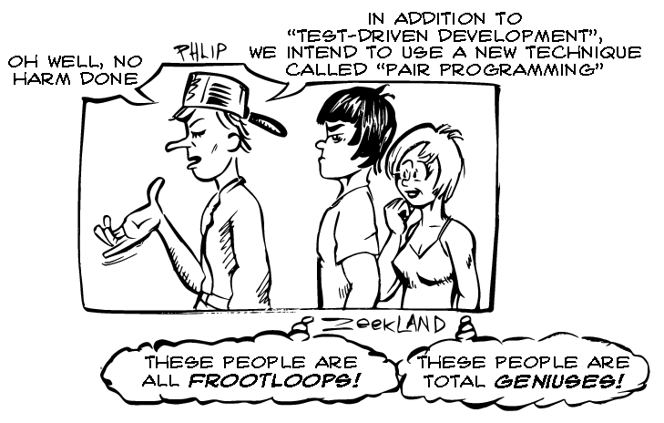

Slide 2
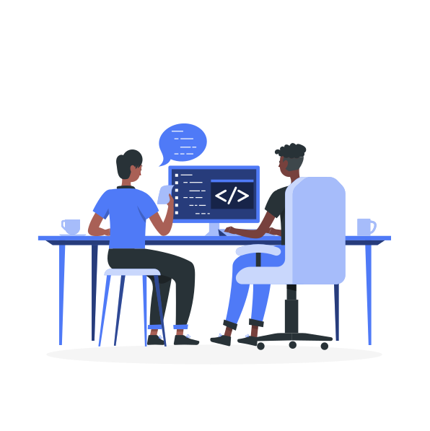
Pair programming

Slide 3
Lone wolf software developer

Slide 4
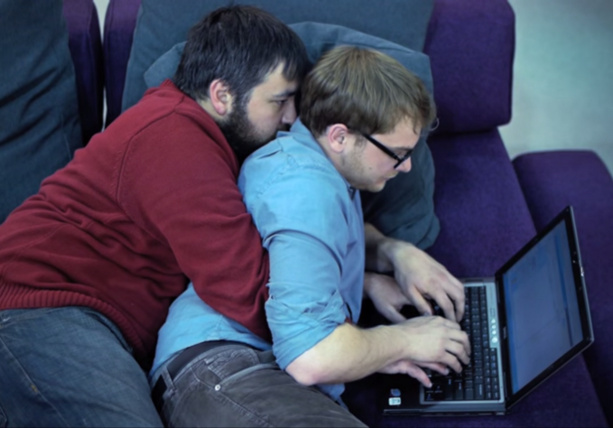
Is this “pair” programming ?

Slide 5
What is it “pair” programming?
Pair programming essentially means that two people write code together. It is a very collaborative way of working and involves a lot of communication. While a pair of developers work on a task together, they do not only write code, they also plan and discuss their work.

Slide 6
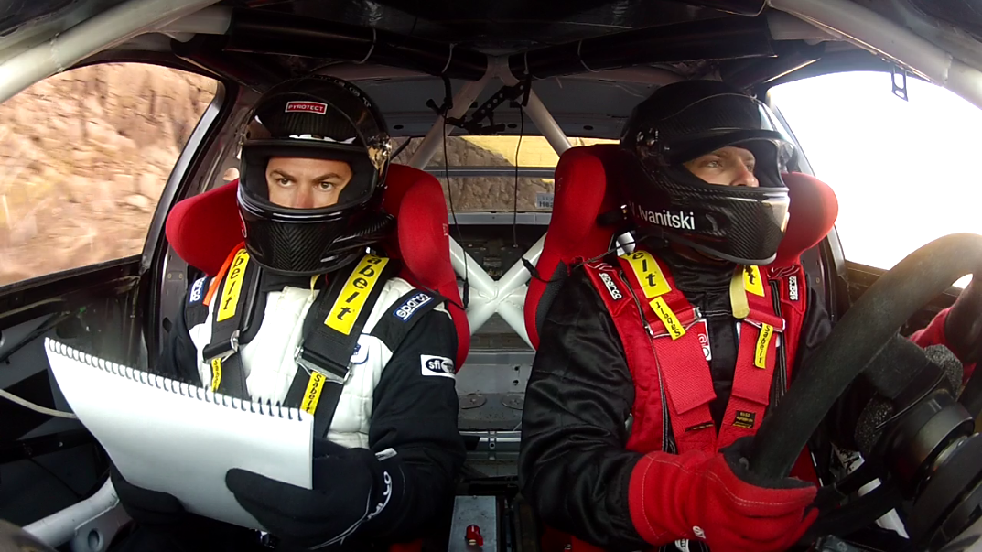

Slide 7
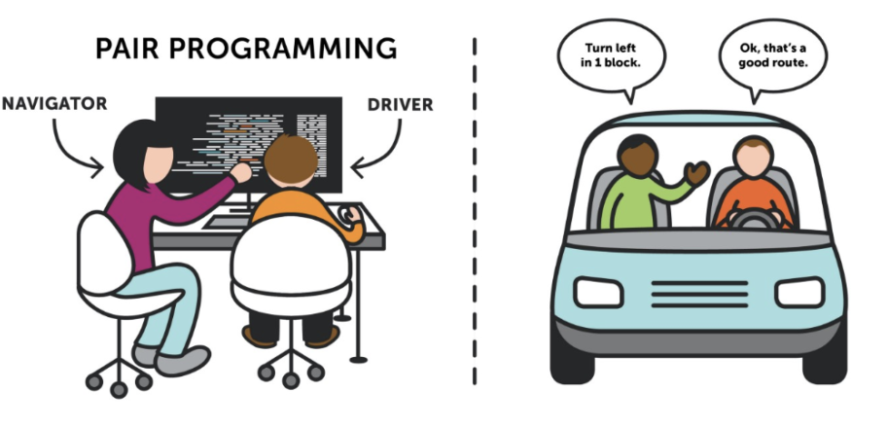
How do we “pair” ?

Slide 8
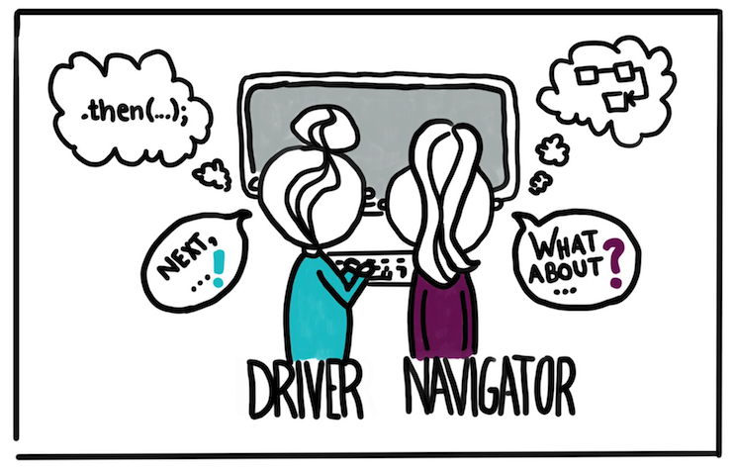
Driver and navigator
Diver is the person on the wheel i.e. keyboard. S\he is focused on completing the goal at hand (tactical), ignoring larger issues for the moment. A driver should always talk through what s\he is doing while doing.
Navigator is in the observer position, while the driver is typing. S\he reviews the code on-the-go, gives directions and shares thoughts. The navigator also has an eye on the larger issues(strategy), bugs, and makes notes of potential next steps or obstacles.

Slide 9
Driver and navigator… continued
Things to remember
The keyboard needs to be shifted between the driver & navigator
The skillset should be more similar
The idea of this role division is to have two different perspectives on the code. The driver's thinking is supposed to be more tactical, thinking about the details, the lines of code at hand. The navigator can think more strategically in their observing role.

Slide 10
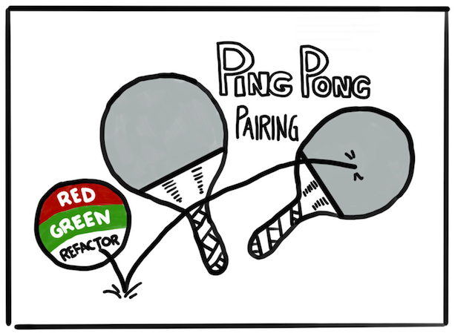
Ping pong
This technique embraces Test-Driven Development (TDD) and is perfect when you have a clearly defined task that can be implemented in a test-driven way.

Slide 11
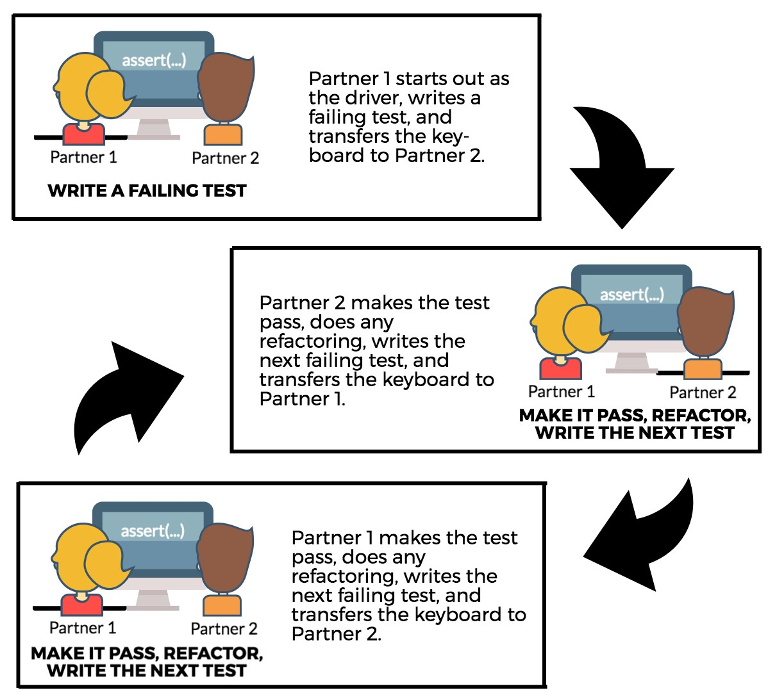
Ping pong… continued

Slide 12
Ping pong… continued
Things to remember
The keyboard needs to be shifted between the driver & navigator
The skillset should be more similar
Each "Pong" can also be followed by refactoring the code together, before you move on to the next failing test. This way you follow the "Red - Green - Refactor" approach: Write a failing test (red), make it pass with the minimum necessary means (green), and then refactor.

Slide 13
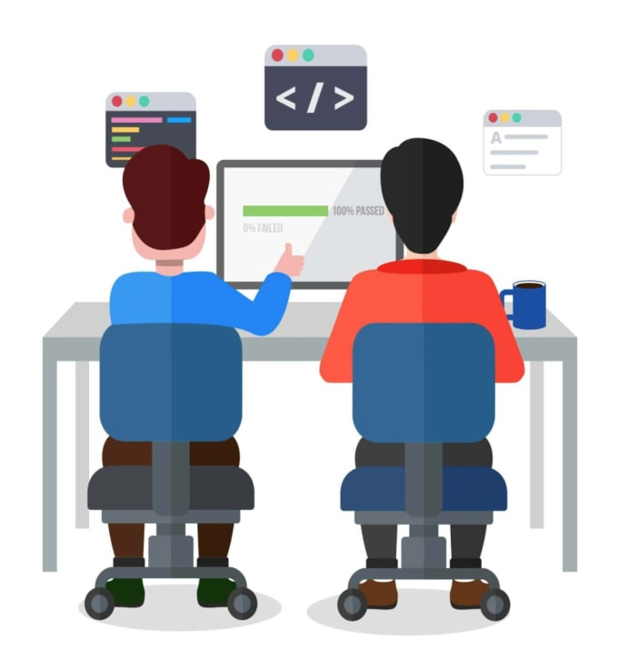
Strong style
This is a technique particularly useful for knowledge transfer and coaching
For an idea to go from your head to the computer it must go through someone else’s hands. - Llewellyn Falco

Slide 14
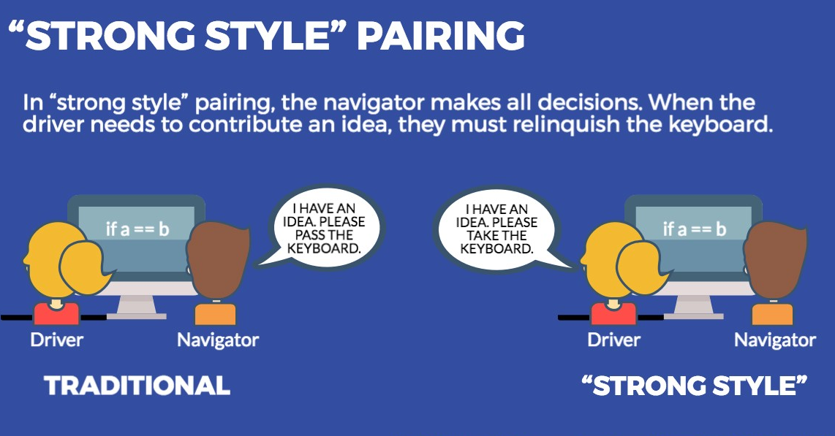

Slide 15
Strong style… continued
Things to remember
In this style, the navigator is usually the person much more experienced with the setup or task at hand, while the driver is a novice (with the language, the tool, the codebase, ...). The experienced person mostly stays in the navigator role and guides the novice.
An important aspect of this is the idea that the driver totally trusts the navigator and should be "comfortable with incomplete understanding". Questions of "why", and challenges to the solution should be discussed after the implementation session. In a setting where one person is a total novice, this can make the pairing much more effective.

Slide 16
Time management

Slide 17


Slide 18
https://pomofocus.io

Slide 19
Setup

Slide 20

Network

Slide 21

Use Video

Slide 22
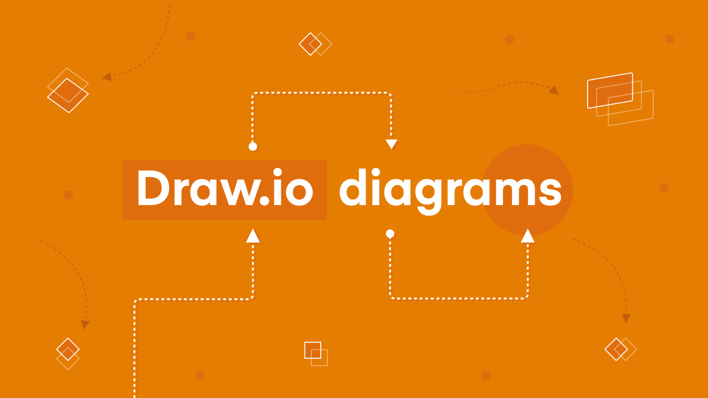
Design

Slide 23


Slide 24


Slide 25
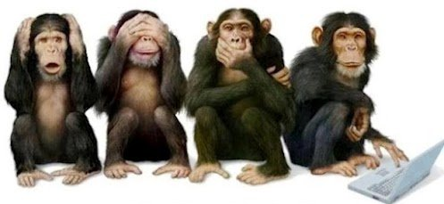
Things to avoid

Slide 26

No “interruption”
email
phone
meetings

Slide 27
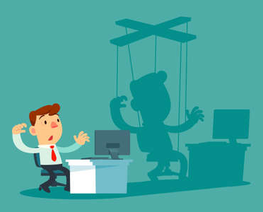
Do not “micro-manage”
"Now type 'System, dot, print, "...
"Now we need to create a new class called..."
"Press command shift O..."

Slide 28

"5 seconds rule"
When the navigator sees the driver do something "wrong" and wants to comment, wait at least 5 seconds before you say something - the driver might already have it in mind, then you are needlessly interrupting their flow.

Slide 29
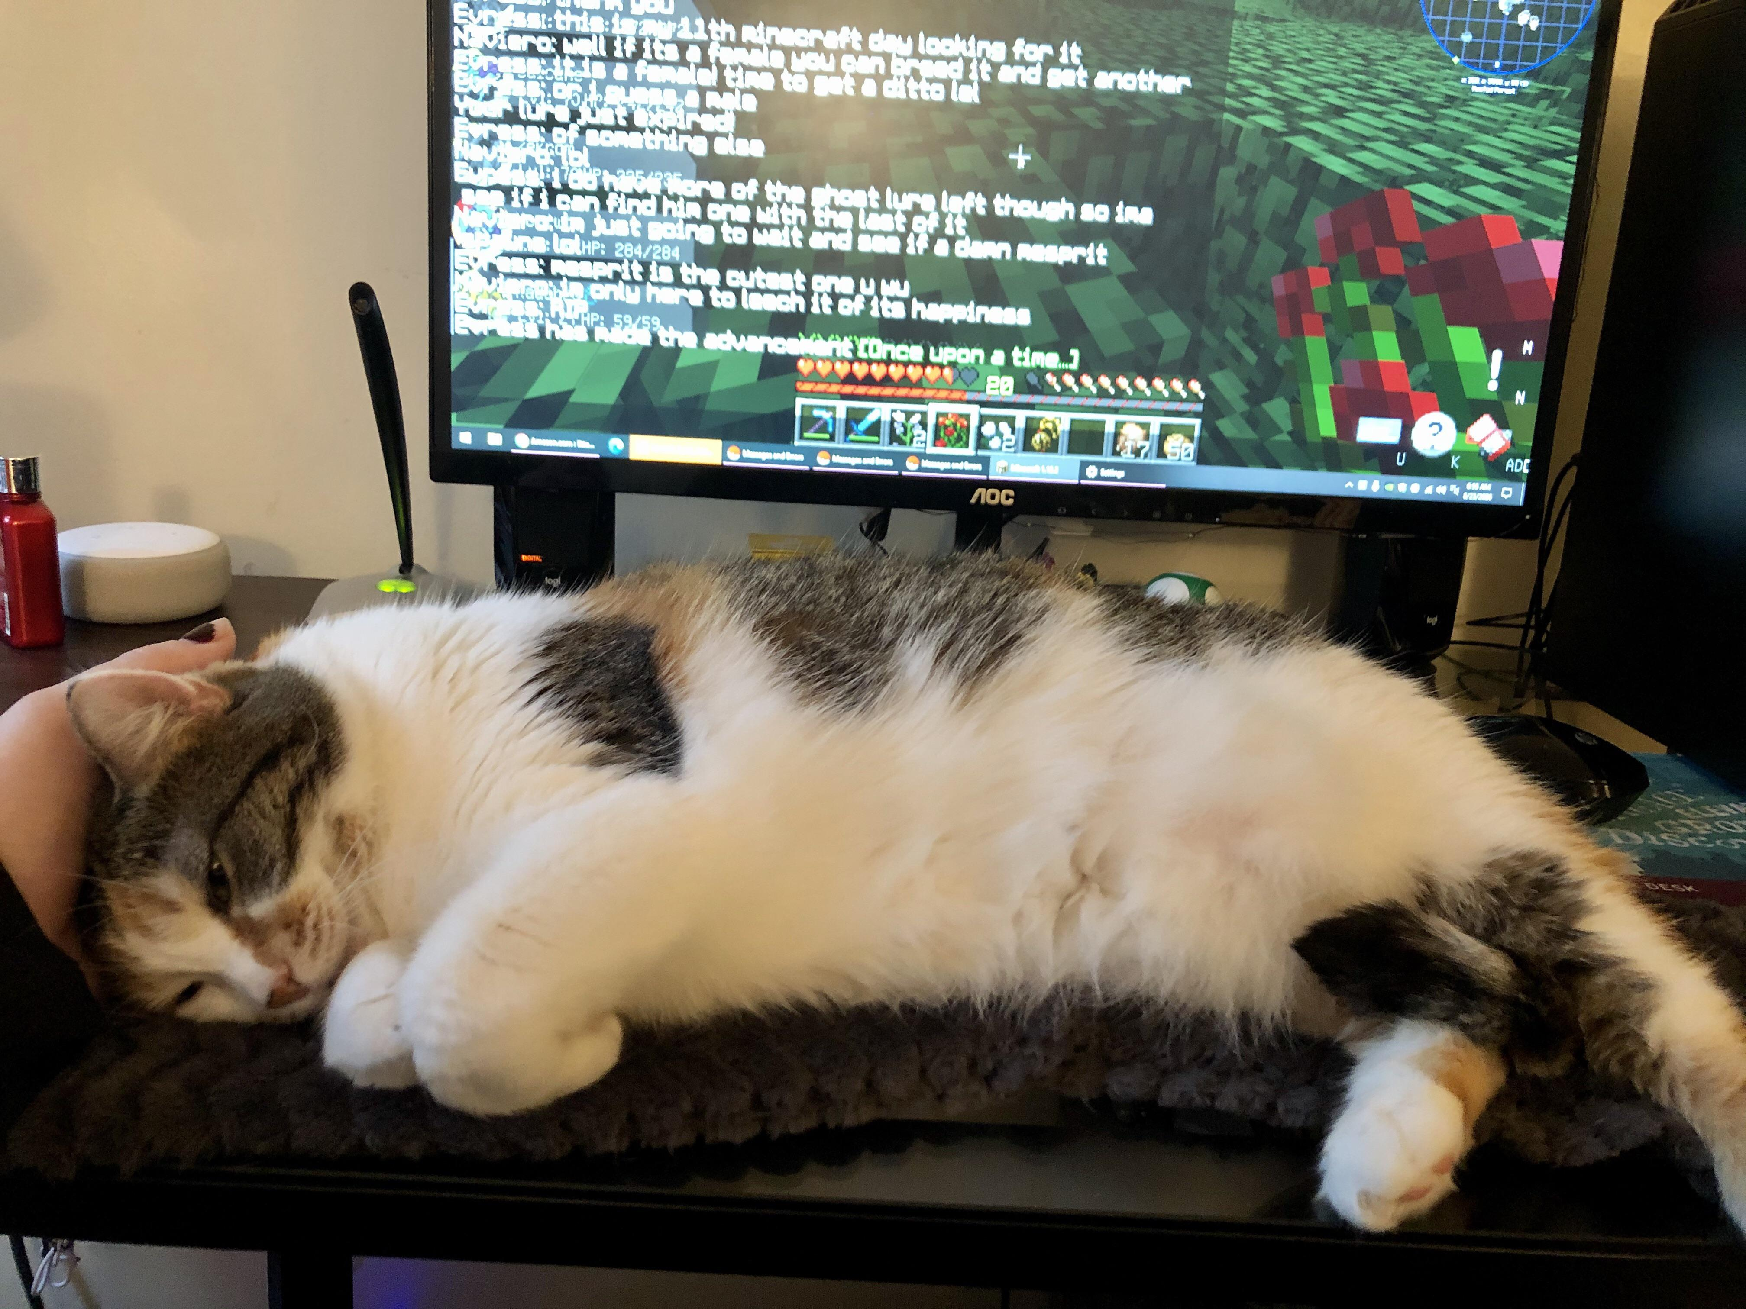
Keyboard Hogging
Are you controlling it all the time, not letting your pairing partner do some typing as well?

Slide 30

There is no "THE" right way

Slide 31
